Slide 1
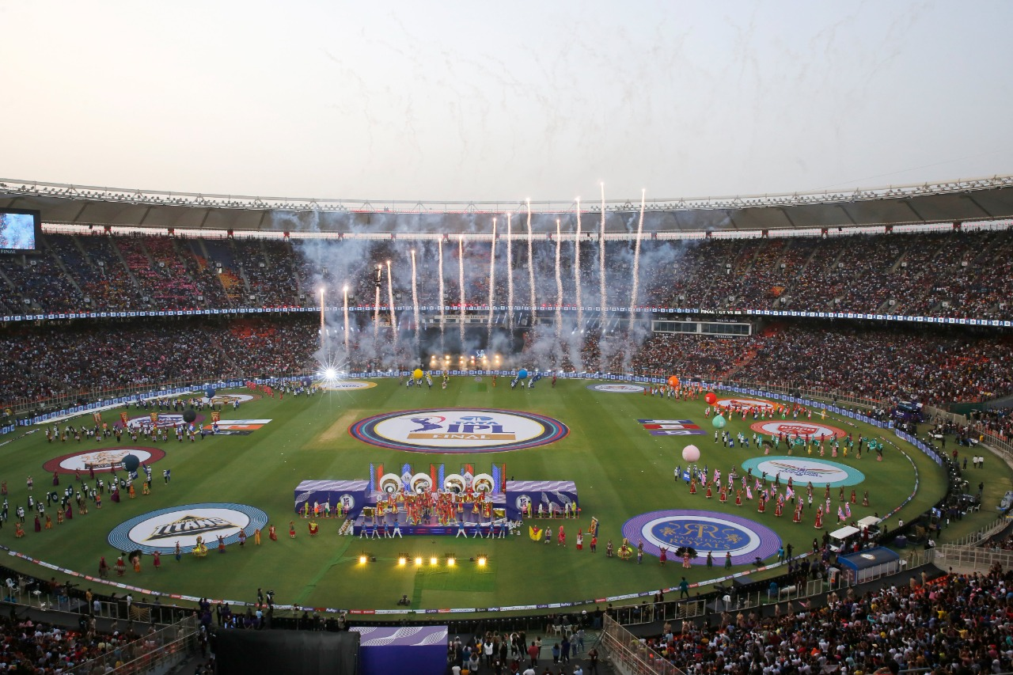
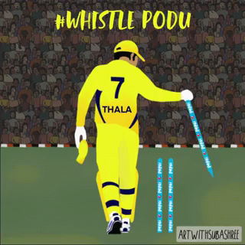
IPL Fan Engagement Analysis
By – Nazarene Mustoor
B.Tech CSE (VIII)
A80105220088

Slide 2







Table of Contents:
Introduction
Future Research
Discussion
Limitations
Conclusion
Analysis and Results
Methodology
01
02
04
06
03
05
07

Slide 3
Table of Contents:
Introduction
Methodology
Analysis and Results
Discussion
Conclusion
Future Research
Limitations
01
02
03
04
05
06
07

Slide 4
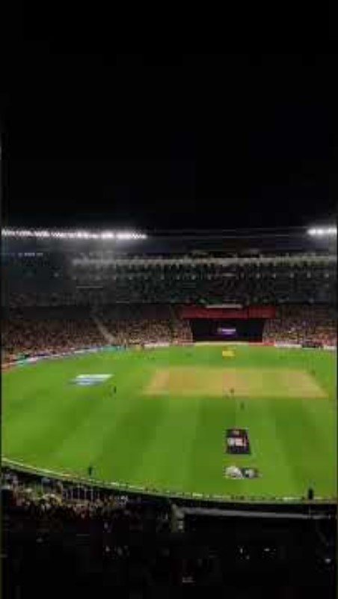
This thesis investigates the correlation between fan engagement intensity during critical moments of Indian Premier League (IPL) matches and the performance of individual players.

Slide 5
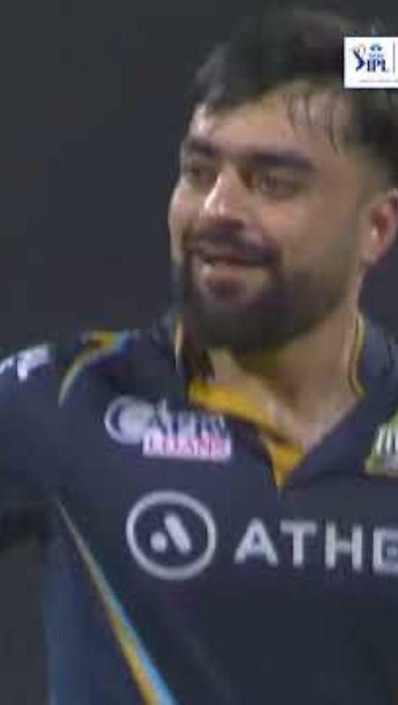
SAMPLE:

Slide 6
To analyze the impact of fan engagement on cricket players’ performance in IPL.

Slide 7
How does the intensity of fan engagement during critical moments in IPL matches affect the performance of players?
[Critical moments such as close finishes, pivotal overs, key wickets, or match-turning moments.]

Slide 8
The Influence of Digital and Social Media on Sports
The 14th Season of IPL and the Evolution of OTT Platforms in India
Cricket and the Impact of Live Scores on Fan Engagement

Slide 9
GAPS IN LITERATURE:
Limited Focus on IPL's Digital Media Impact
Insufficient Analysis of Real-time Fan Engagement
Lack of Empirical Data on Fan Engagement and Player Performance
Absence of Comparative Analysis
Unexplored Future Trends

Slide 10
TECH STACK
DATA COLLECTION
STATISTICAL METHOD

Slide 11
TECH STACK
Python and Libraries:
BeautifulSoup
Selenium and WebDriver
Vader from nltk
Pandas, NumPy, SciPy
Matplotlib, Plotly, Seaborn
Jupyter Notebook
Power BI and DAX

Slide 12
Four Tables-
Critical Moments
Player Stats
Fan Engagement Metrics
Sentiment Scores
DATA COLLECTION
Critical Moments
Player Stats
Fan Engagement Metrics
Sentiment Scores
TECH STACK

Slide 13
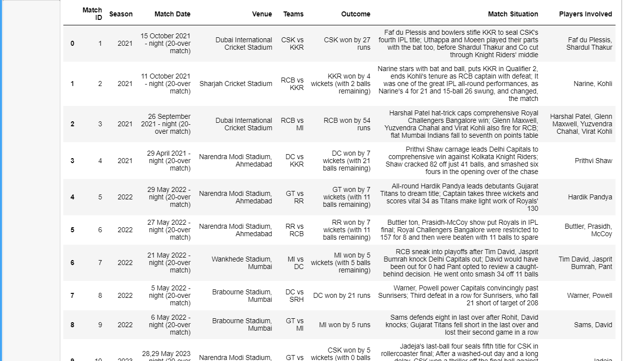
critical_moments_in_ipl

Slide 14
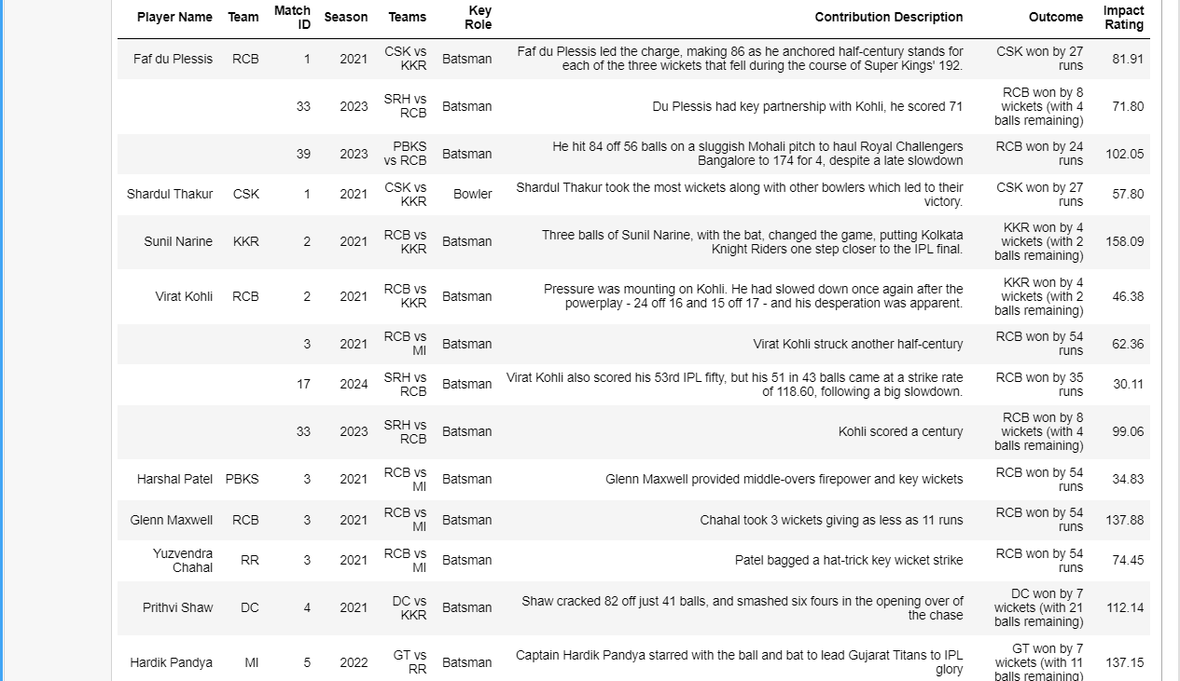
player_stats_in_critical_moments

Slide 15
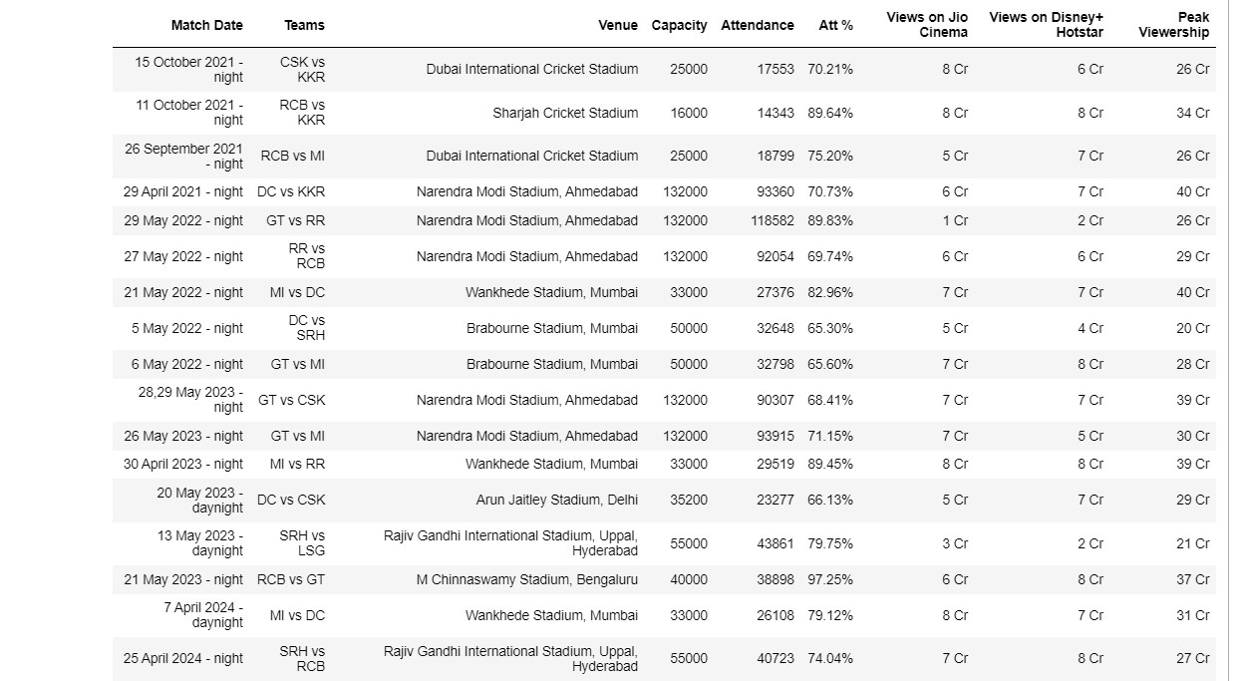
fan_engagement_metrics

Slide 16
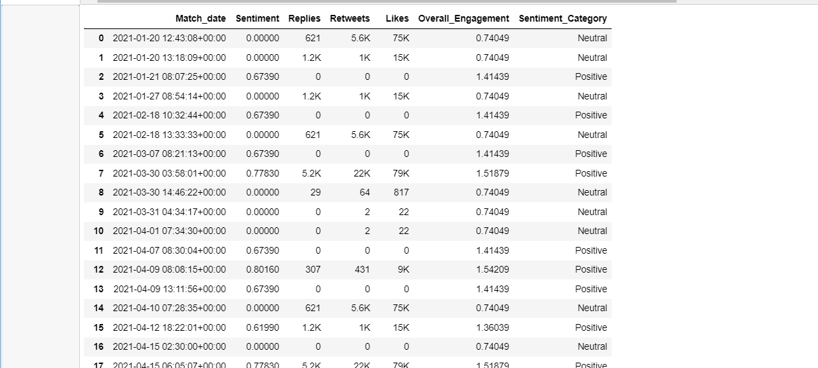
sentiment_scores

Slide 17
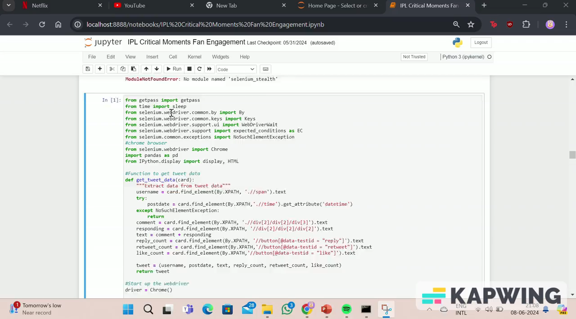
TWITTER WEB SCRAPING

Slide 18
Four Tables-
Critical Moments
Player Stats
Fan Engagement Metrics
Sentiment Scores
The T-test is a statistical test used to determine if there is a significant difference between the means of two groups. The primary purpose of the T-test is to test the null hypothesis that the means of two populations are equal.
Justification for Using T-Test
Comparison of Two Groups
Handling Small Sample Sizes:
Why Other Statistical Methods Were Not Chosen
ANOVA (Analysis of Variance)
Chi-Square Test
Regression Analysis
STATISTICAL METHOD
TECH STACK
DATA COLLECTION

Slide 19
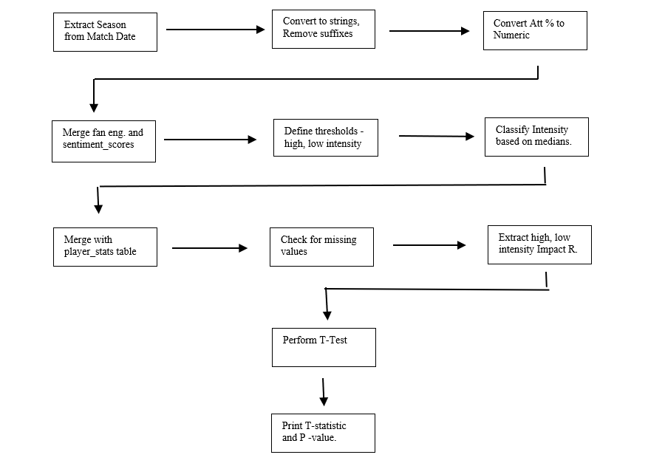
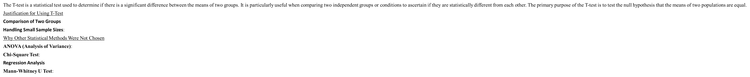

Slide 21
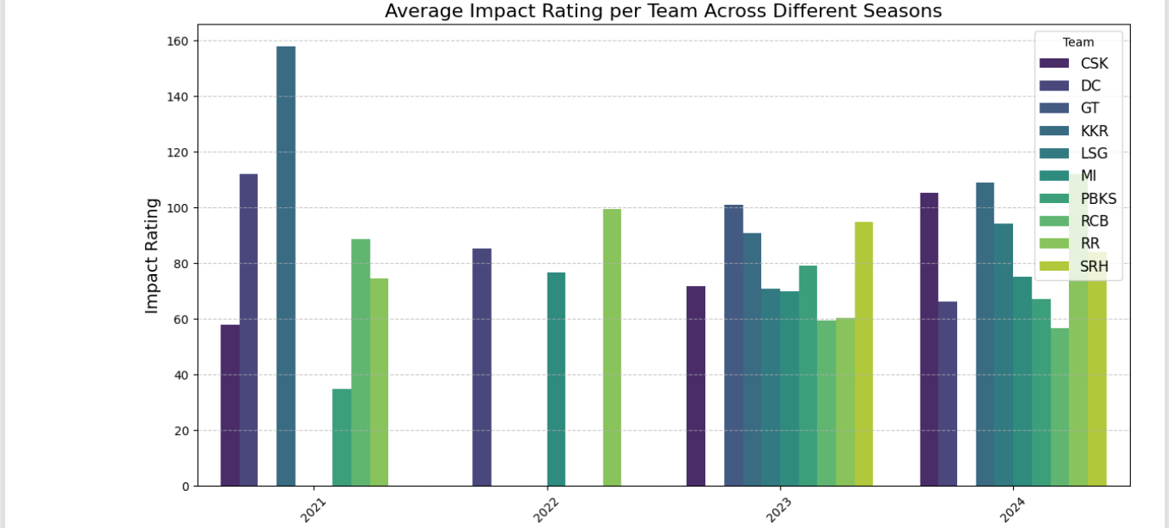
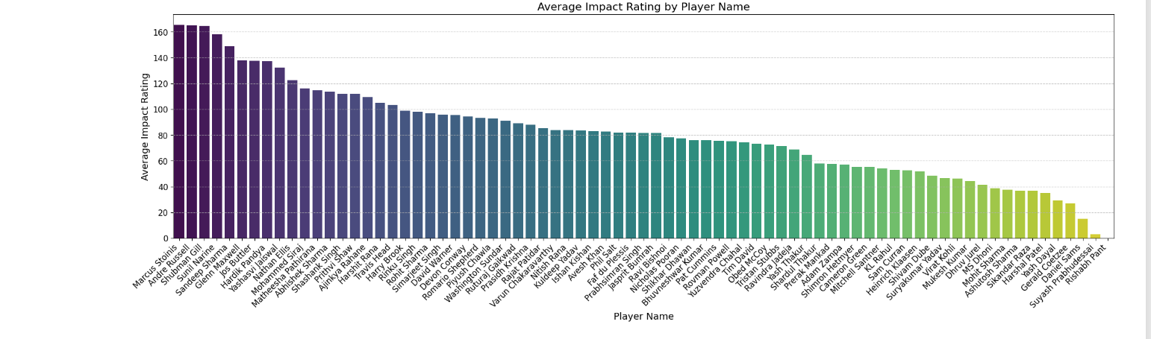
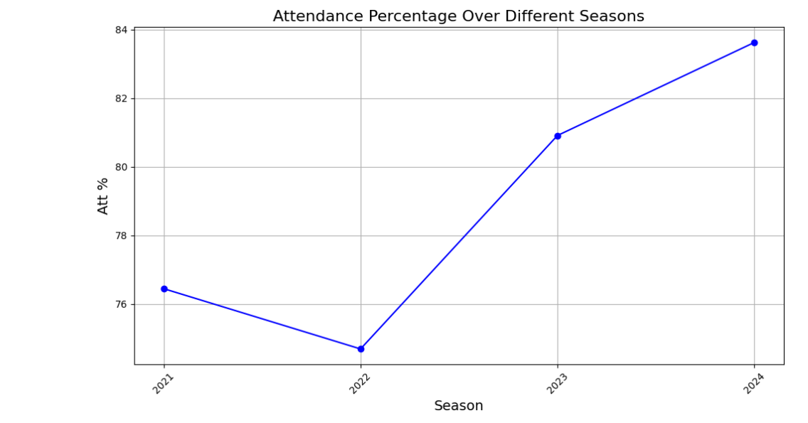
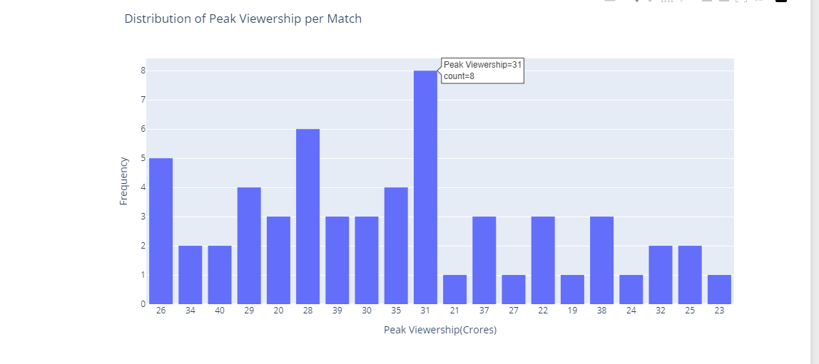

Slide 22
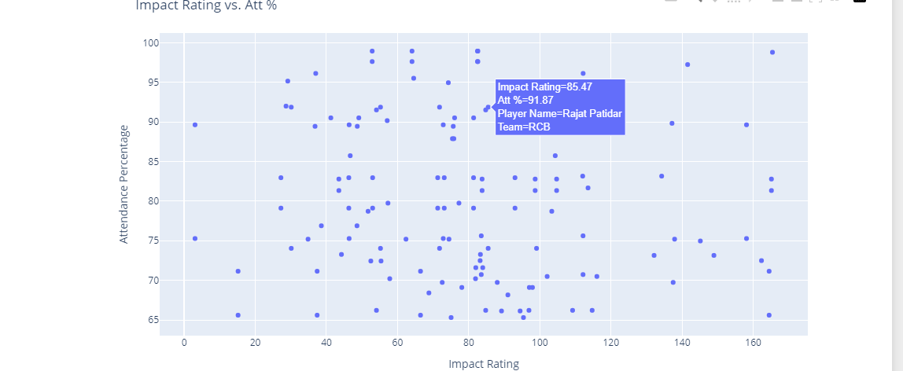
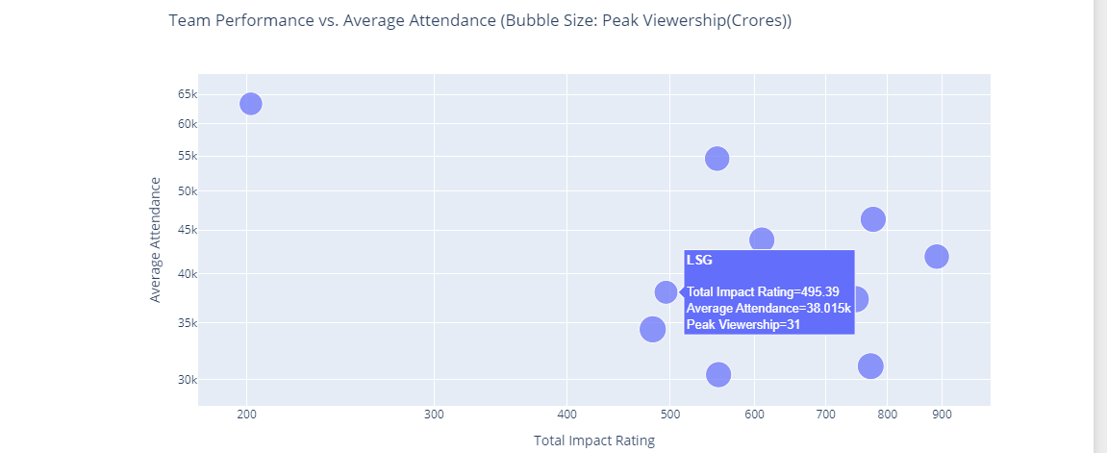
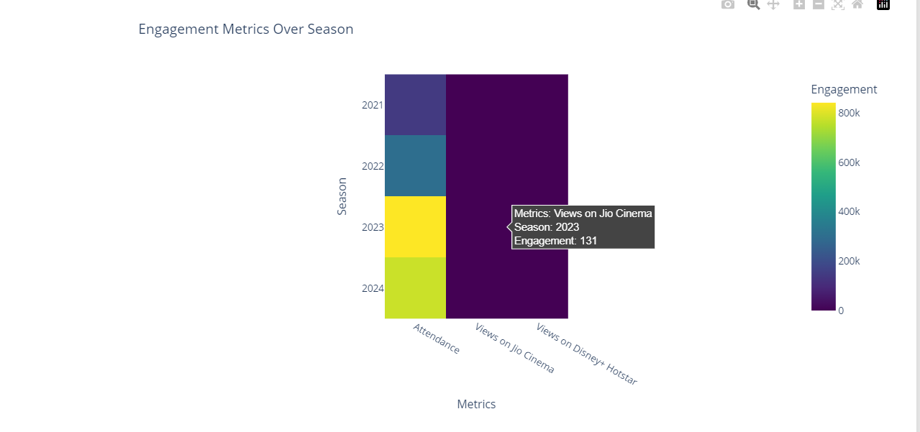
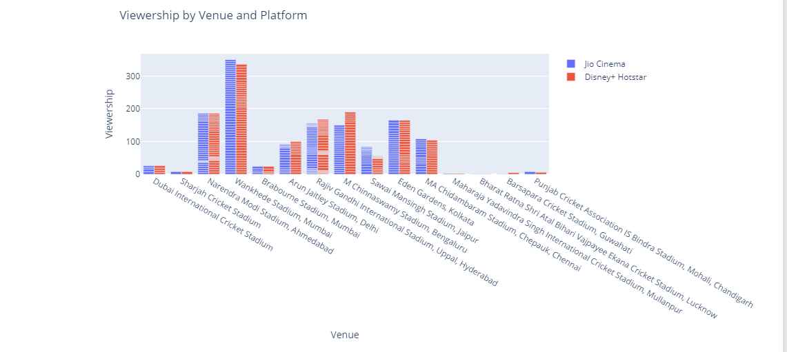

Slide 23
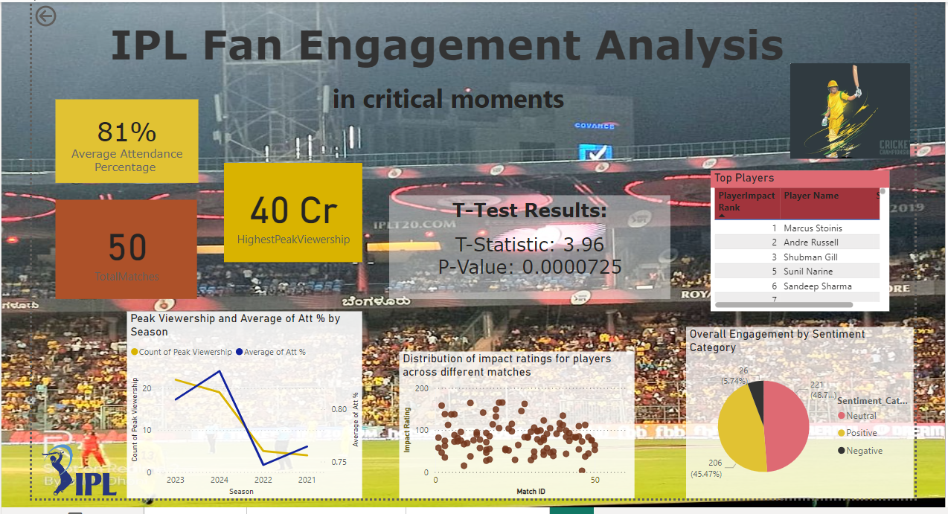

Slide 24
T- statistic = 3.96
P- value = 7.25e-05 ( which is 0.0000725)

Slide 26
T-statistic(3.96) measures the size of the difference relative to the variation in the sample data. Suggests a substantial difference between the groups.
P-value (0.0000725) indicates that the probability of observing the data, given that the null hypothesis is true.
Rejection of the Null Hypothesis
Statistical Significance
Practical Application
Further Research

Slide 27
In conclusion, there is a significant impact of fan engagement on players’ performance.
If the intensity of fan engagement is high, the player performance is better, and if the intensity of fan engagement is low then the player performance is low.

Slide 28
Exploration of the long-term psychological effects of real-time engagement on fans and players.
Virtual reality (VR) and augmented reality (AR) on the fan experience.
The role of data analytics and artificial intelligence (AI) in personalizing fan experiences
Cross-cultural studies could provide a deeper understanding of how digital and social media influence sports consumption in different regions.

Slide 29
Social Media rate – limiting
Difficulty gathering match venue and viewership on OTT platforms
Identifying matches that had critical moments over different IPL seasons was a complex and time-consuming task.
Reliance on publicly available data, which may not always be complete or accurate.
Focusing primarily on quantitative data, overlooking qualitative aspects.
Study's geographical focus on the Indian Premier League

Slide 30

